Slide 1

Django Backend Adaptation for Frontend Migration to React
Eduardo Ezponda
Trabajo de Fin de Grado I 250890

Slide 2

Innovation consultancy for the management of funded technology projects
SPLOROTECH

Slide 3

Platform for managing funded innovation projects

Slide 4
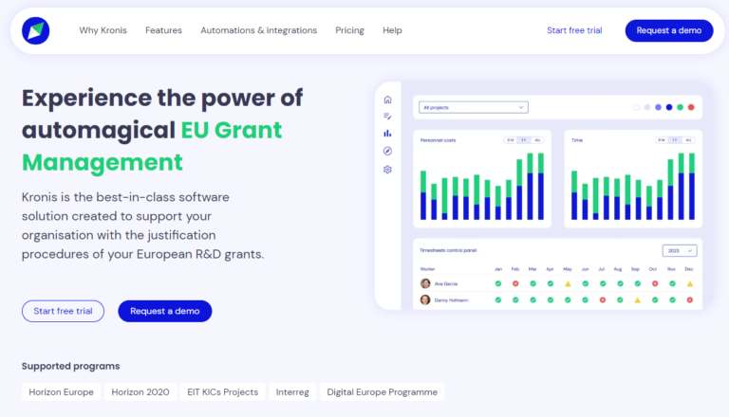
Planning, implementation and monitoring of project phases

Slide 5

Problems in Kronis
Scalability: Difficulty in finding profiles with full Django experience

Slide 6

Solution
Migration to React/NextJS to separate backend and frontend

Slide 7

Adaptation
API: adapting Django to communicate with React

Slide 8

Objectives
Optimisation
Scalability
User experience
Efficiency

Slide 9
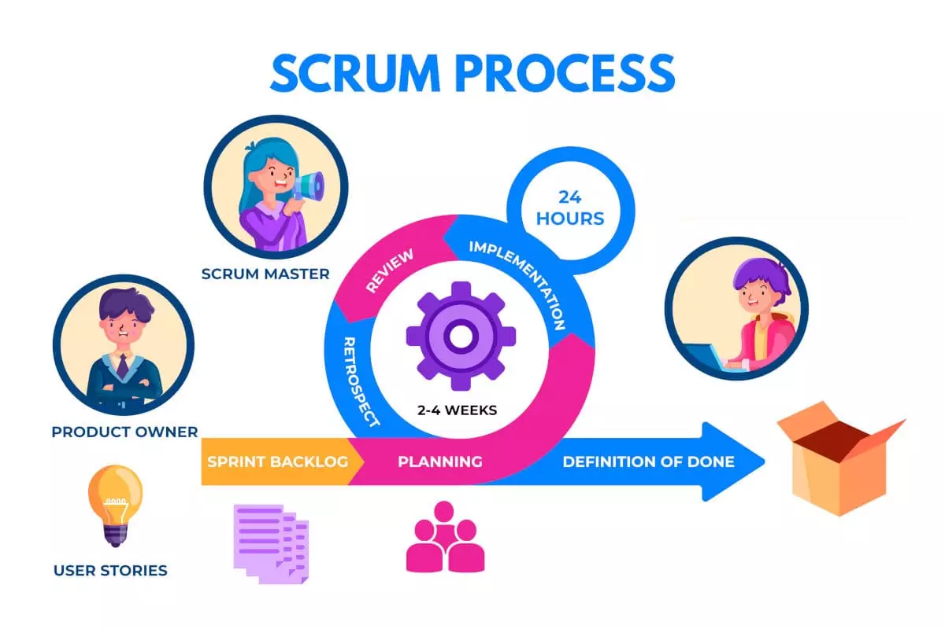

Methodology
Scrum is an agile framework for managing projects, focusing on collaboration, iterations and incremental deliveries.
Sprint 1
Sprint 2

Slide 10
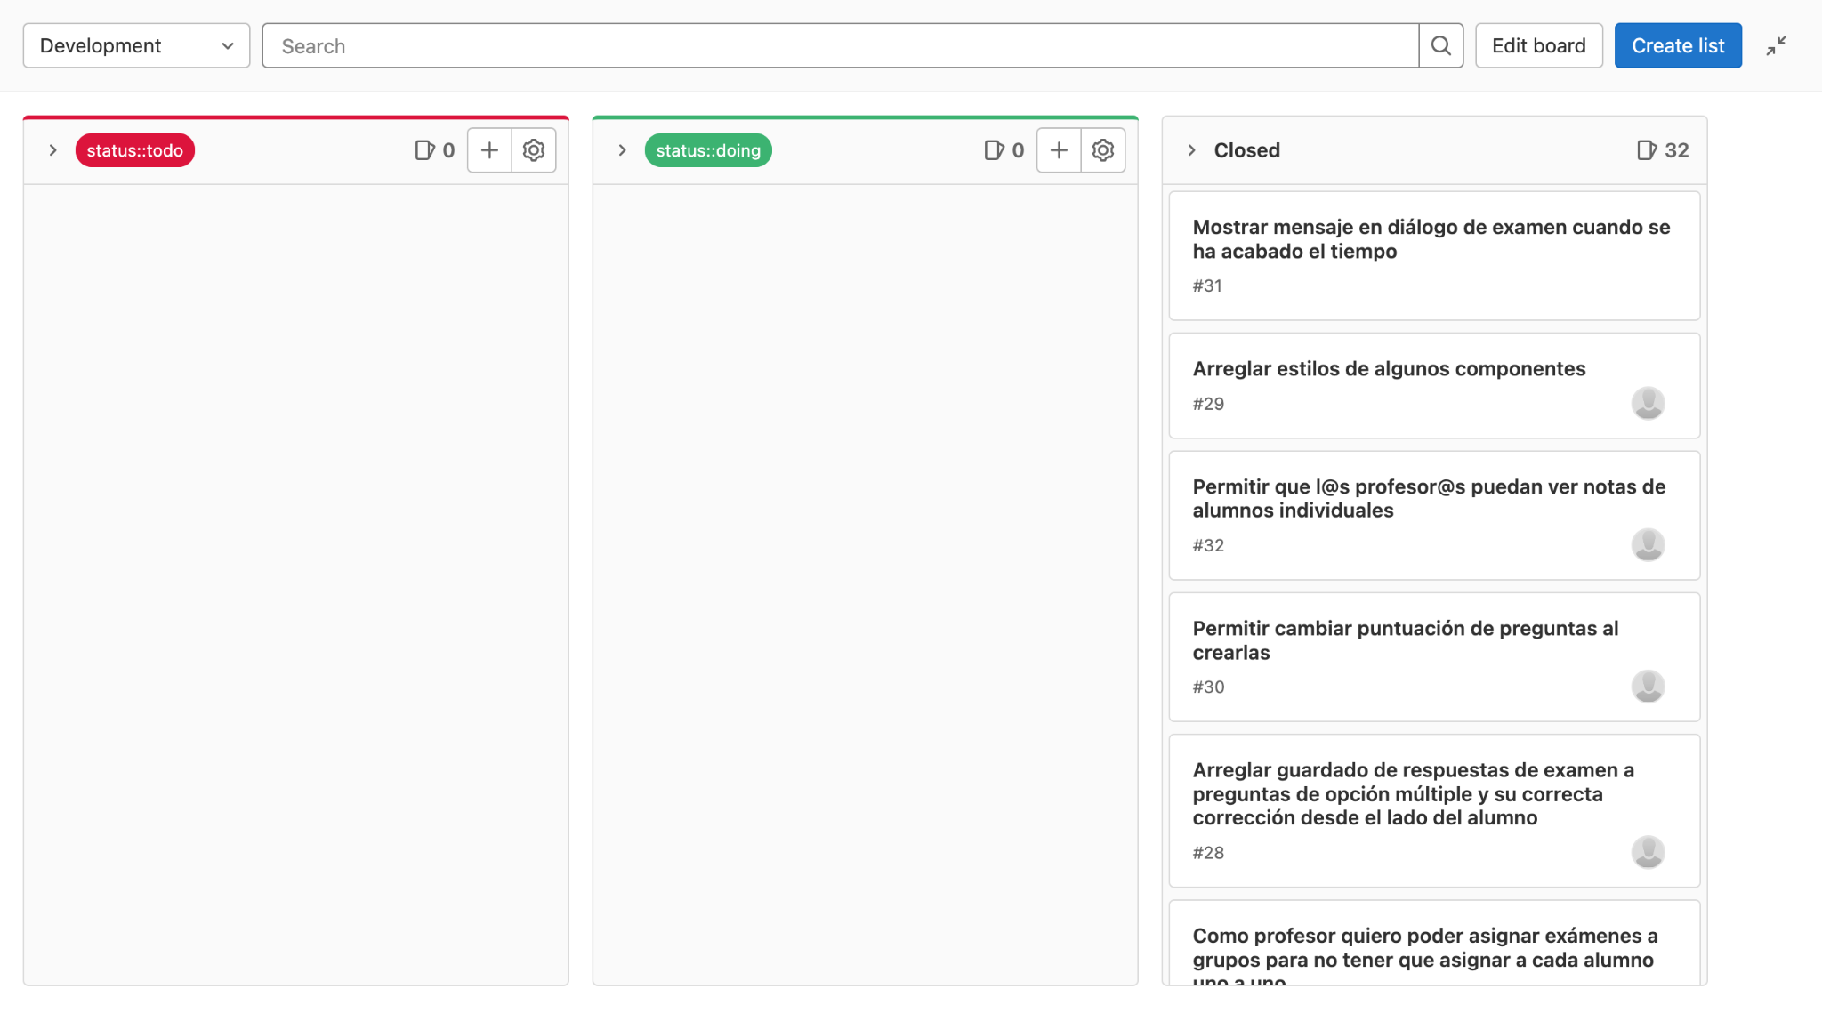
GitHub:
Version control platform for easy project management to organise tasks

Slide 11

Backend development
Django

Slide 12
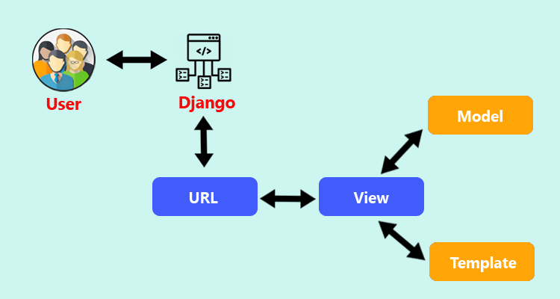
Django
Model - View - Template Pattern:
Model → Business logic and Data
View → User interaction
Template → Data presentation

Slide 13

Django Rest Framework (DRF)
API creating with Django
JSON data exposure
Simplify development

Slide 14

Frontend development
NextJS

Slide 15

NextJS
React Framework → high-performance apps
Hybrid rendering:
SSR: Faster initial load
SSG: Optimized static content

Slide 16


Kronis Architecture
Docker: Frontend, Backend, PostgreSQL, Redis
AWS: Frontend, Backend, load balancers

Slide 17

Silk
Optimises DB queries
Identifies inefficiencies
Integrates with Django

Slide 18
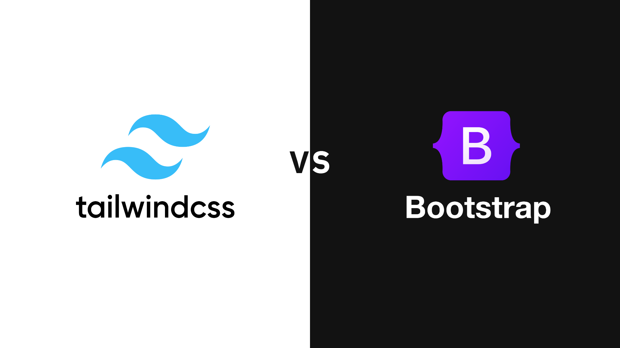
Migration: Bootstrap to Tailwind CSS
Before (Django + Bootstrap):
Predefined styles, less flexibility
After (NextJS + Tailwind):
Utility-first, customization

Slide 19
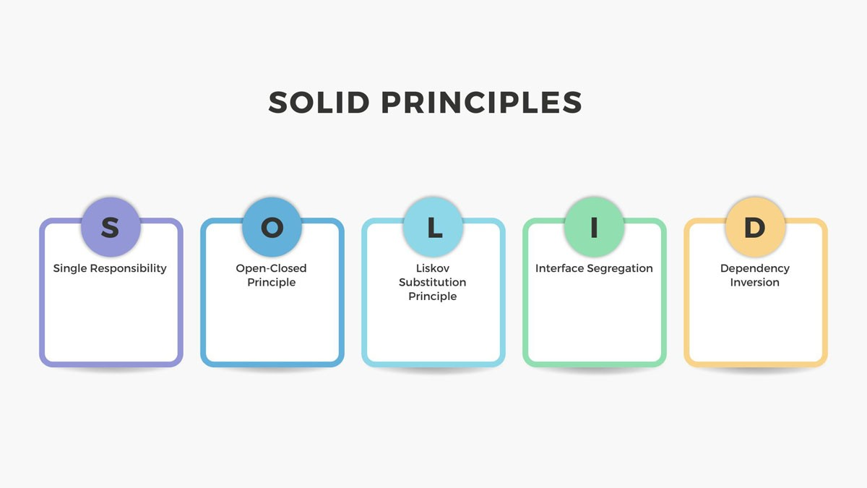
Frontend project

Slide 20

Project modifications
CRUD endpoints → Models
Travel actions

Slide 21

Timesheets - CRUD Endpoints
CRUD operations for models in Timesheets

Slide 22

Travel Actions - Endpoints
Actions for travel management:
Close
Request reopen
Cancel reopen request
Reopen
Accept/Reject reopen requests

Slide 23


Development of a web interface
Facilitate API interaction
Structured way to test API endpoints

Slide 24
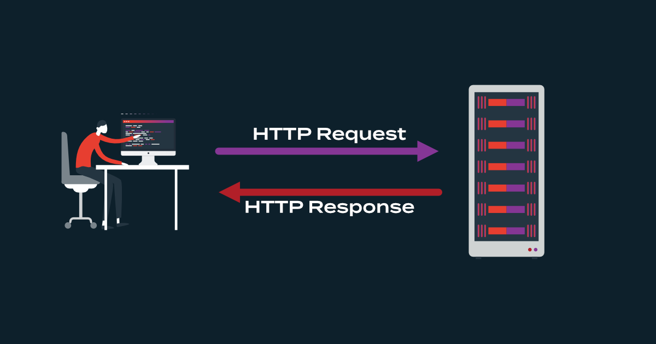
Interface features
GET, POST, PUT, DELETE requests
Dynamic Data Insertion
Response visualization

Slide 25
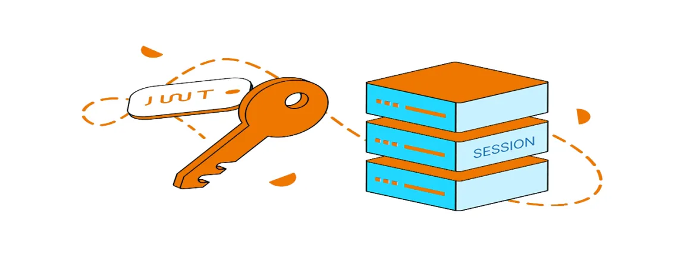
Authentication and security
Login system
Session token authentication for requests

Slide 26
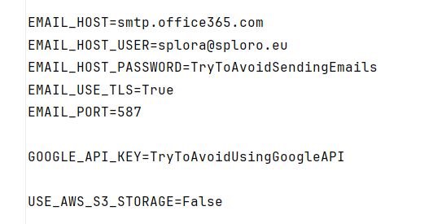
Local implementation of Kronis
Removed dependency on sensitive data
Maintained essential settings

Slide 27
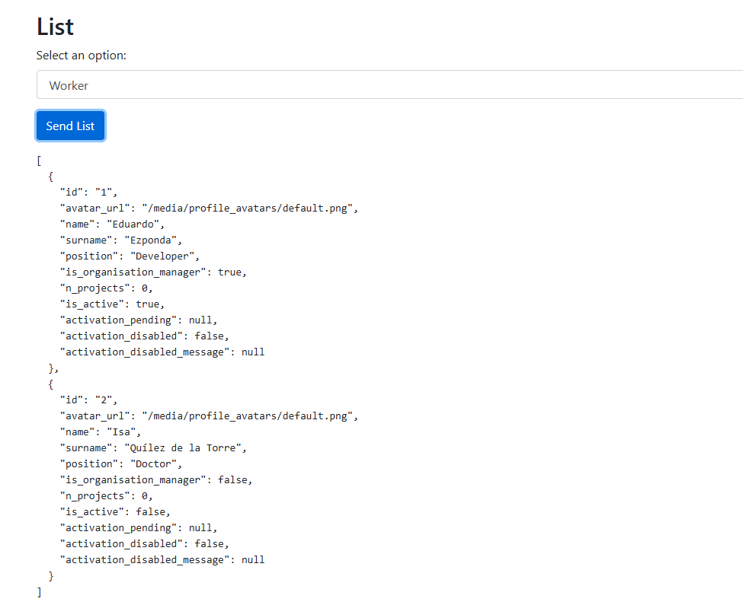
Example of an API response

Slide 28


Unit testing
No need for an active database
Detects errors before deployment

Slide 29
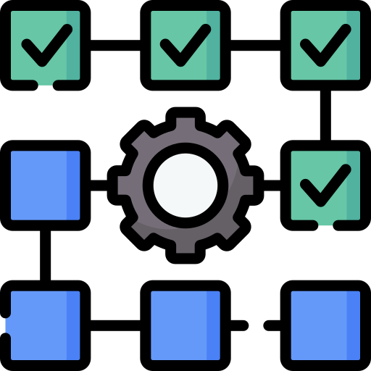
Unit testing
Ensures functionality without database access
Mocks to simulate dependencies

Slide 30

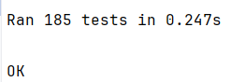
Unit testing
186 tests executed successfully ✅

Slide 31
Future lines
Kronis will evolve with EU subsidy needs
Splorotech aims for full automation
Become a leader in efficient innovation project solutions

Slide 32
Django Backend Adaptation for Frontend Migration to React
Eduardo Ezponda
Trabajo de Fin de Grado I 250890

